Slide 1
UNIT
DAY 7
01
THE DRAFT
GAMES OF LOGIC
AGENDA
REMINDERS
Phones into The Holding Cell
Laptops open from the start. You need them all period today
Today Is Different
Your Mechanic Bank
Shortlist Three
Client Cards
The Draft
Product Analysis
Design Folder

Slide 2

TODAY IS DIFFERENT
No new computer science content today!
Today you choose what you are building
  Playtest 1 is Day 12 – September 29. Your first real players are four lessons away
By the end of the period every one of you owns a concept and a format

Slide 3

THE SITUATION, AGAIN
Advisory periods and club meetings end with fifteen dead minutes
The games on the shelf take longer to explain than they take to play
Your clients are the other people in this room. Not a hypothetical person
  They are sitting here right now, which is convenient, because you are about to interview them

Slide 4
YOUR RESEARCH ALREADY EXISTS
Open the Mechanic Bank. Go to your tab
Four entries. Two mechanics each. Eight ideas you wrote yourself since Day 3
  Go through all of these before you think of any new ideas
Nobody in this room is starting from nothing today

Slide 5

SHORTLIST THREE
The grid is eight forms across, four concepts down. Thirty-two cells.
Pick three cells, in order. First, second, third
  Your first choice needs one sentence: why does this concept need this form?
  Not "it would be cool". Why this form and not a different one

Slide 6
WHAT A GOOD PAIRING LOOKS LIKE
Two examples, and neither is on your grid, so you cannot take them
Sorting algorithms × trick-taking - a trick is a comparison between two cards, and a sort is nothing but repeated comparisons. The form is the concept
Network routing × tile-laying - routing is about paths and congestion, which are spatial, and tile-laying is the spatial form
  In both, swap the form and the concept stops working. That is the test

Slide 7
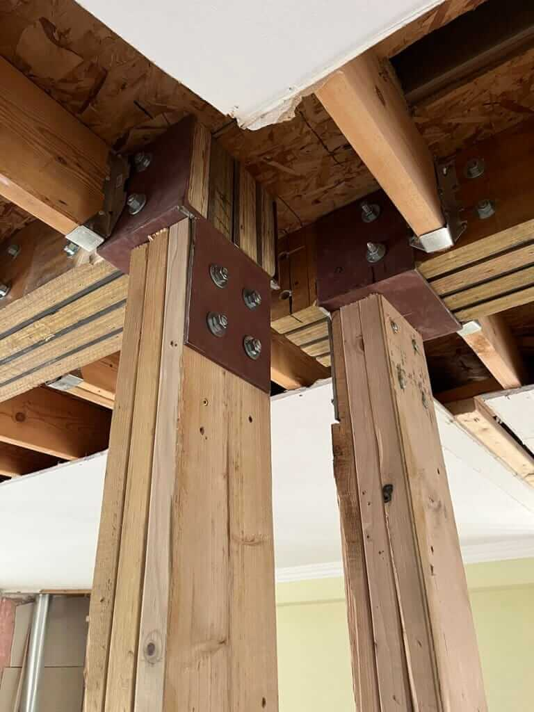
THE LOAD-BEARING TEST
Delete the computer science from your idea
Is there still a game?
  If yes, you have a theme. Send it back and start again
  If the whole thing collapses, the concept is load-bearing and you are clear to build
This goes into your specification on Day 9 as a mandatory success criterion, so you will be tested against it either way

Slide 8
CLIENT CARDS
Top half of the card only, and answer about yourself, honestly
How long are your dead minutes? How many people are usually around? What is the longest rules explanation you will sit through? Name a game you refused to play twice
Every card goes on the front desk and we photograph the whole set at once
  That photo is your primary research, and it goes on slide 6 of your folder

Slide 9
THE DRAFT: HOW IT WORKS
Bottom half of the card. First, second, third choice, plus your one sentence
All cards in at the same time
Uncontested cells lock immediately and I write your name in the grid
  Most of you will get your first choice. There are thirty-two cells after all.

Slide 10

THE DRAFT: CONTESTED CELLS
Two people on the same cell: read your sentence
You are not pitching your game. You are answering one question:
  Why does this concept need this form?
Better sentence takes the cell. The other one drops to their second choice, which will be free
  Tiebreak, if you are both good: explain why you can’t do this idea in any other format

Slide 11

NOW GO AND RESEARCH
Twenty-five minutes, and the first three are planning. No internet yet
  Write down what you need to find out, and which of those matters most. That is folder slide 4, next time
Then go. You know what you are building, so the research is targeted
Find two existing games that do something near your cell, and take them apart
  Minutes to teach. Minutes to play. Where the real decision sits
  And the one that matters: what does this game do that mine will have to do?
→ Folder slides 8 and 9

Slide 12
YOUR DESIGN FOLDER
One Google Slides deck. One link, one file, nothing to lose
Every slide is already titled. You’re just filling it in
One slide per entry, dated. Photograph paperwork and drop it straight in
  This is what gets submitted on 13 October and it is most of your grade for the unit

Slide 13
BEFORE YOU LEAVE
Slide 1 - your name and your locked claim
Slide 3 - the design situation, in your own words
Slide 6 - the photo of the client cards
Slide 7 - three things the client data actually tells you. Numbers, not impressions
Slides 8 and 9 - your two product analyses, started
Slide 10 - your Day 2 dissection sheet, photographed in
  Slide 4 stays empty for now. We do the research plan next time

Slide 14
CLOSING
You have a concept, a form, a client, and data from your peers
Nobody else in this room is building your game
Next time:
  The design brief. Everything you gathered today, argued into one page - your first summative - Criterion A

